Slide 1
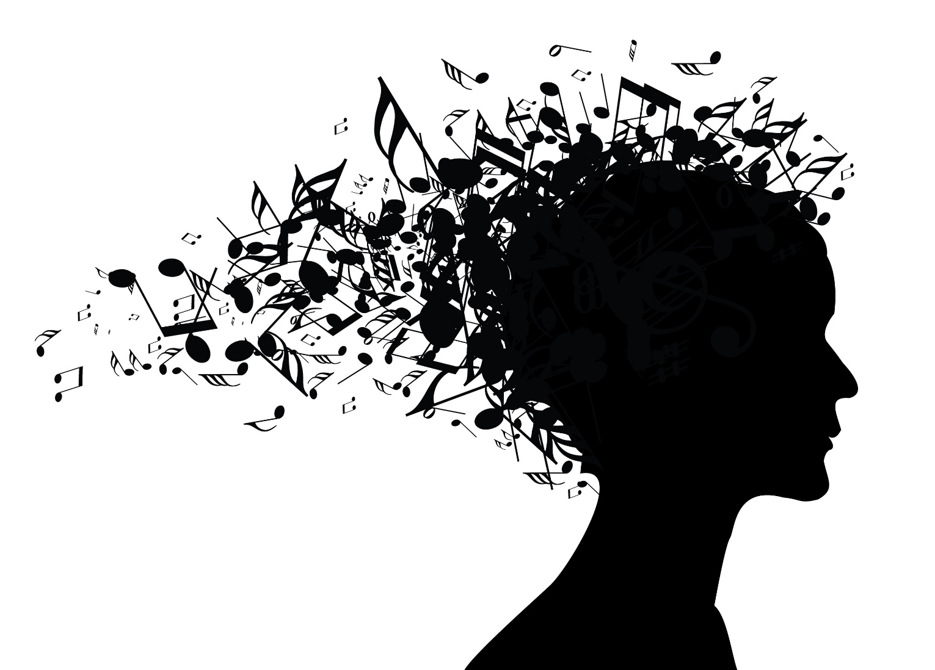
Generating music with LSTM
MSBA7011 Managing and Mining Big Data Audiophile

Slide 2
WORKING AGENDA
Revival of Queen/Freddy Mercury
Data Collecting/Cleaning
Methodology/Architecture
Trial 1 (10 epochs)
Trial 1.5 (40 epochs)
Trial 2 (Queen 100 epoch) loss 0.3
Trial 2.5 (Beethoven 100 epoch) loss 0.2
Trial 3 (100 epoch Queen piano only vectors 3 layers) loss 0.5
Reflection
Future improvement (rhythm, more instruments, consistent music)
Piano can be main or background music
Combining all, pop music would not be an issue

Slide 3
Our goal:
Pick one artist, and use his songs as training data
Generate new music using LSTM model.
The model should generate new music in the style of that artist

Slide 4
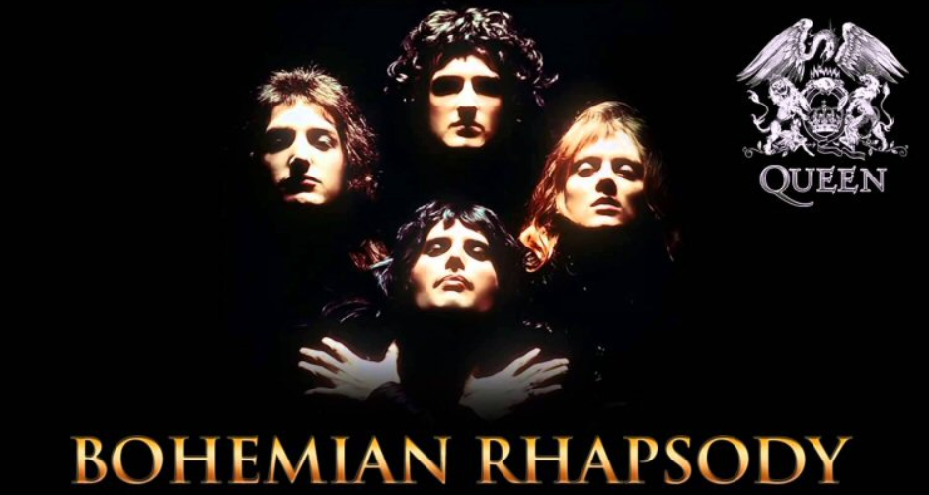
Queen
One of the most famous band in the world. Members: Freddie Mercury, Brian May, Roger Taylor, John Deacon

Slide 5

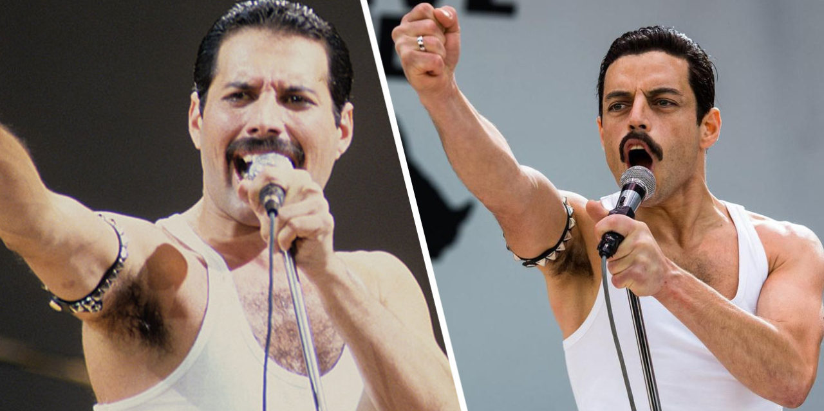
Bohemian Rhapsody (2018)
Biography film of the lead vocalist Freddie Mercury
Oscar Awards: Actor in a Leading Role, Film Editing, Sound Mixing, Sound Editing

Slide 6
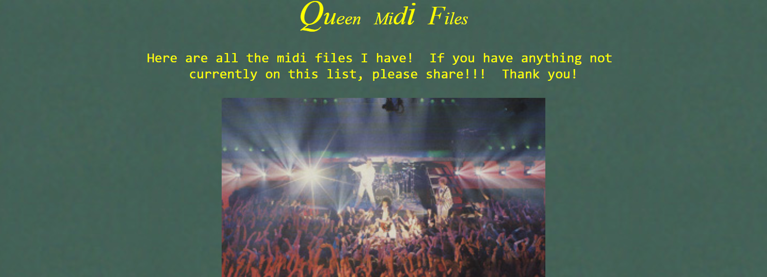
We download data from:
http://tomqueen.tripod.com/midis.html Use 11x Queen’s midi songs as input data

Slide 7
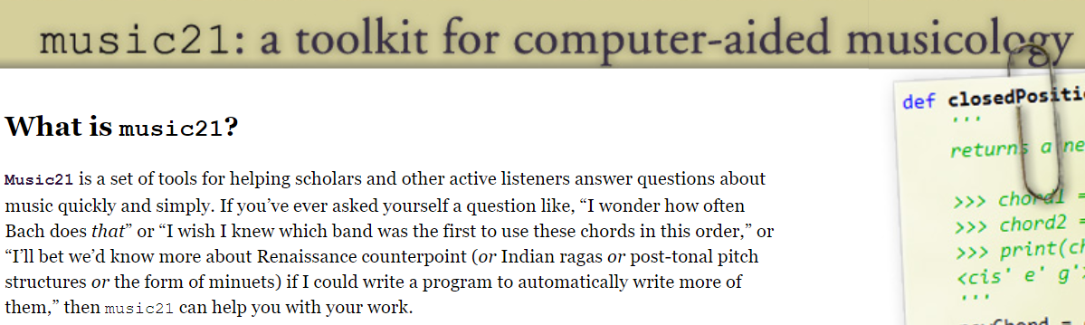
music21
The package we use to handle music data

Slide 8
Softmax
Softmax
Softmax
Dense
Dense
Dense
The model should generate new music in the style of that artist
LSTM Layer 3
LSTM Layer 3
LSTM Layer 3
Dropout
Dropout
Dropout
Dense
Dense
Dense
LSTM Layer 2
LSTM Layer 2
LSTM Layer 2
Dropout
Dropout
Dropout
LSTM Layer 1
LSTM Layer 1
LSTM Layer 1

Slide 11
Our results:
___ Layers
Sequence of layers
The model should generate new music in the style of that artist

Slide 12

Our first try…

Slide 13
Our results:
___ Layers
Sequence of layers
The model should generate new music in the style of that artist

Slide 14
Implementations:
___ Layers
Sequence of layers
The model should generate new music in the style of that artist

